Slide 1
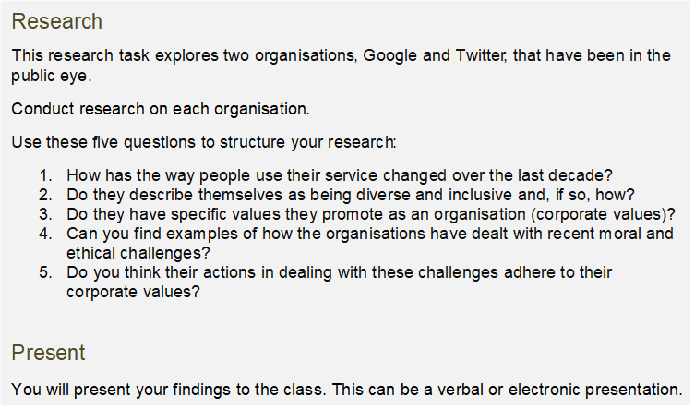

Slide 2
How has the way people use Google changed over the past decade?
Over the past decade the number of mobile searches has overtaken the number of searched on desktop devices
Google has also given the users the ability to use voice and image search, allowing for finding more accurate results
In more recent years the use of the google search engine has declined due to the rise of AI platforms such as OpenAI’s ChatGPT

